Slide 1


BAN6800: Business analytics capstone
Milestone 1: Business Analytics Project-Ready Dataset.
Taco-Tel’s Shield360 Project
Data Collection & Preparation for Churn Prediction
VOKE HARRISON EDAFEJIMUE
Learner ID: 143304

Slide 2

Project: Overview
Subscriber churn is a sensitive issue in the Telecommunications industry as it negatively impacts revenue generation, market share, and brand reputation. Preserving existing customers is more cost-effective than gaining new subscribers, therefore, churn prediction is a core business revolutionary solution.
The Shield360 project focuses on understanding, preprocessing, and transforming the existing data, to identify key drivers of subscriber churn at Taco-Tel. Building a clean and reliable dataset is fundamental to achieving the project’s goals. Bias-free data analysis will help the company extract insights, finetune customer loyalty strategies, and ultimately reduce churn.
Technology & Tools to be used
Python – an easy-to-understand programming language for data analysis
Pandas – a Python library for manipulating data.
Matplotlib – for data visualizations.
Jupyter Notebook – used for user-interactive data exploration.
Kaggle.com – online dataset repository.
GitHub.com – an online repository for sharing and storing code and data. Also, used for version control.

Slide 3
Data Sources
Taco-Tel’s data is sourced from the company’s departments: billing, customer service, and sales. The data collection process ensures that the project achieves the goal of predicting which subscribers are likely to ditch the company’s services.
Therefore, six data sources have been identified;
Dataset | Columns | Description
Telco_customer_churn.csv | Customer ID, Churn Label, Phone Service, Multiple Lines, Internet Service, etc. | This main dataset contains subscriber demographics, subscription type, tenure, and churn state.
Telco_customer_churn_demographics.csv | Customer ID, Gender, Age, Number of Dependents, etc. | The demographics dataset provides personal information about each subscriber.
Telco_customer_churn_location.csv | Location ID, Customer ID, Country, State, City, Zip Code, etc. | This file contains the customer’s location details to aid regional segmentation in our churn analysis.
Telco_customer_churn_population.csv | Zip Code and Population. | This dataset stores the number of subscribers per Zip Code to help the company provide sufficient facilities to meet customer needs and avoid churn.
Telco_customer_churn_services.csv | Customer ID, Number of Referrals, Tenure in Months, Offer, Payment Method, Monthly Charge, etc. | This file contains details of the services each subscriber uses.
Telco_customer_churn_status.csv | Customer ID, Satisfaction Score, Churn Label, Churn Reason, etc. | This dataset contains customer feedback on their level of satisfaction and the reasons they opt out of the company’s services.

Slide 4

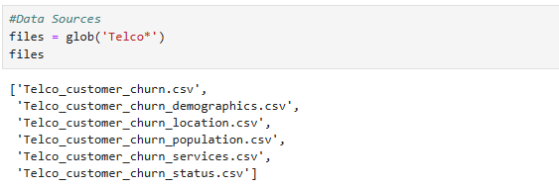
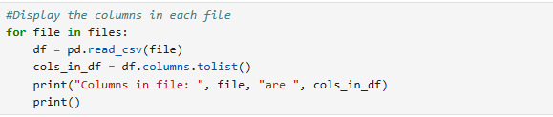
Data Collection tools & methods
To begin the analysis, we import the required libraries. Also, previously identified datasets were loaded into the Jupyter Notebook environment using Python, Pandas, and the Glob module.
The glob module uses a wildcard to match multiple files when you want to process or organize a batch of files.
Pandas is an open-source library, suitable for manipulating data of various types and sources. The column names of each file is then displayed to aid the analysis process.

Slide 5
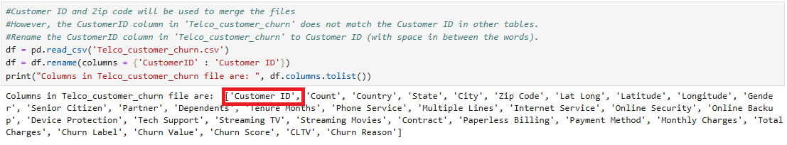
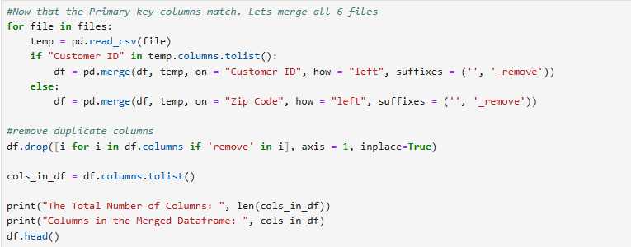
MERGING DATASETS (To ensure compatibility & data integrity)
One of the data sources has its primary key spelled as ‘CustomerID’ as against ‘Customer ID’ in other datasets. First, we match the column names to aid our merging process and display the corrected column name.
Now that the primary key column names match, we use Customer ID and Zip Code to merge all the datasets, generating a Data frame with 63 columns.

Slide 6
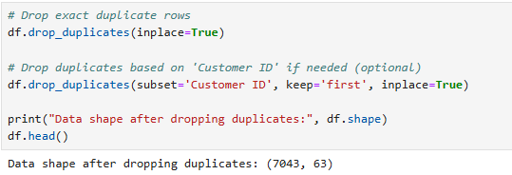
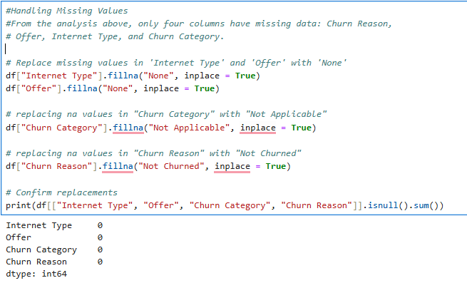
Data Cleaning & Preprocessing
The aim of cleaning our subscriber data is to guarantee data quality, integrity, and reliability of model outcomes (Pykes, 2025).
1. Remove duplicate records to obtain relevant and unique data only.
2. Handle missing values with the mode values for completeness.

Slide 7
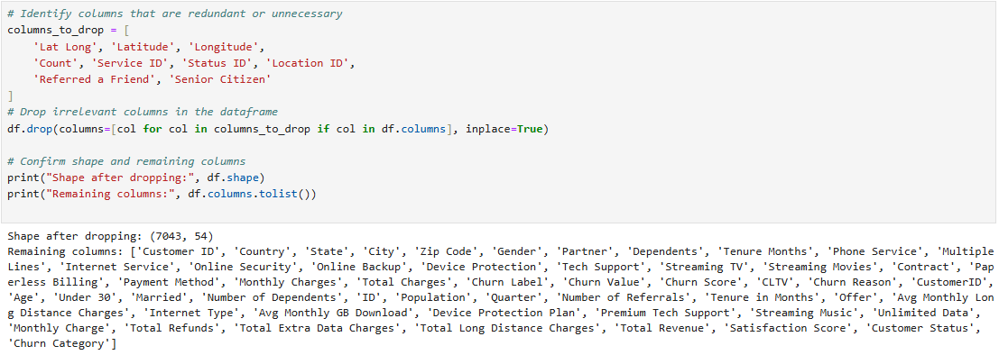
Data Cleaning & Preprocessing
Cont’d
3. Drop Irrelevant Columns for clarity.

Slide 8
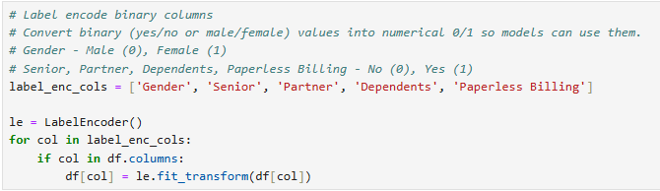
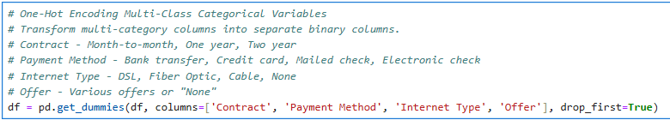
Data Transformation & Feature Engineering
1. Label Encoding for Binary Columns to enhance the model’s outcomes.
2. One-Hot Encoding Multi-Class for Categorical values to avoid machine learning errors (Python Geeks Team, n.d.).

Slide 9
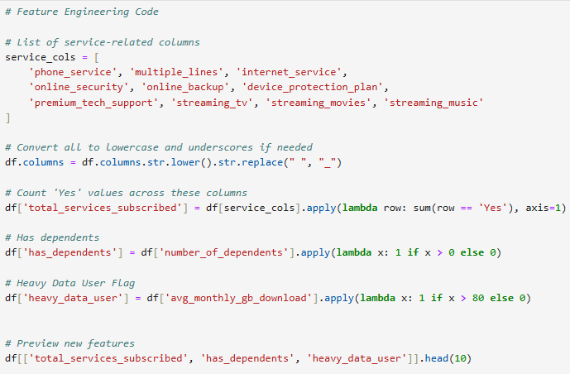
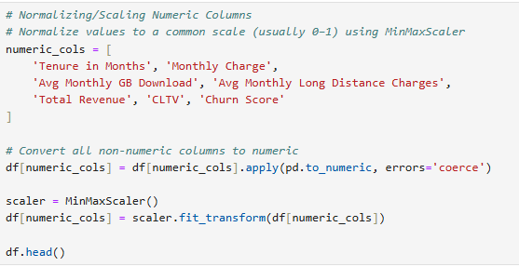
Data Transformation & Feature Engineering cont’d
3. Normalizing/Scaling numerical columns to a scale between 0 to 1 using the ‘MinMaxScaler’ to avoid biases from large values and for better model outcomes (Python Geeks Team, n.d.).
4. Feature engineering to aid deeper insights into the given data and improve the prediction outcome.

Slide 10
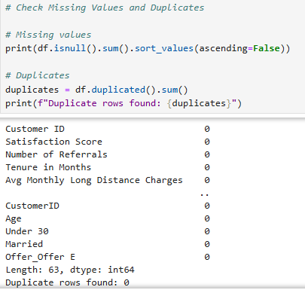
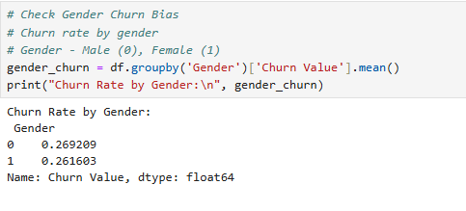

Data Quality Assessment (bias & ethics)
1. Reconfirm that there are no missing or duplicate records. Ensure that the data is clean, complete, and ready for modeling (Gopalam, 2023).
2. Check for bias to ensure reliable model outcomes. We assessed the subscriber churn rate by gender using the statistical mean function. The difference between male and female is less than 1% meaning that gender does not introduce a significant bias. Our model is unlikely to generate bias outcomes against any gender.
3. Save the cleaned dataset. Ensure that no personally identifiable information is used or transmitted for the protection of Taco-Tel’s subscribers. Data must be encrypted when at rest or in transit.

Slide 11
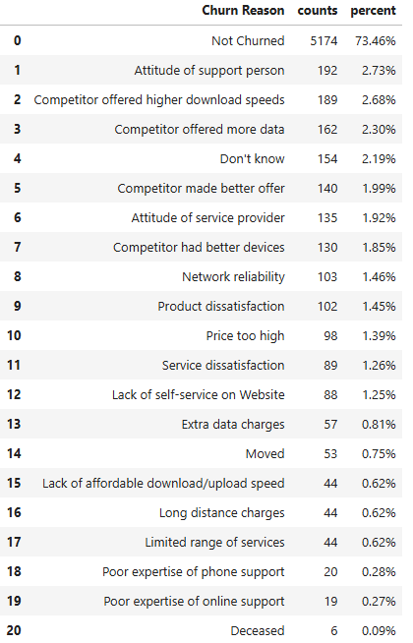
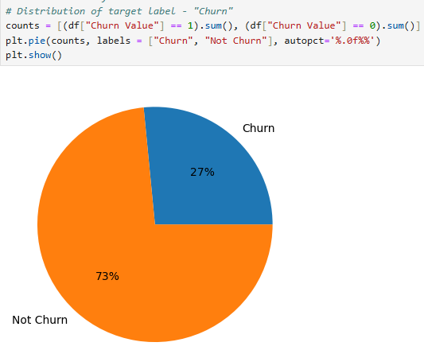
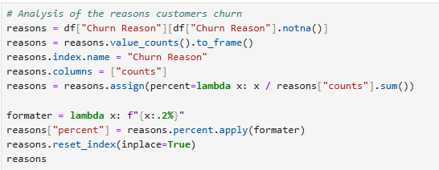
Exploratory Data Analysis
1. Churn Distribution – this analysis helps us understand the distribution of customers who have churned versus the ones who have not abandoned their subscriptions.
2. Churn reasons analysis in a table with percentages to identify the most popular reasons for churn.

Slide 12
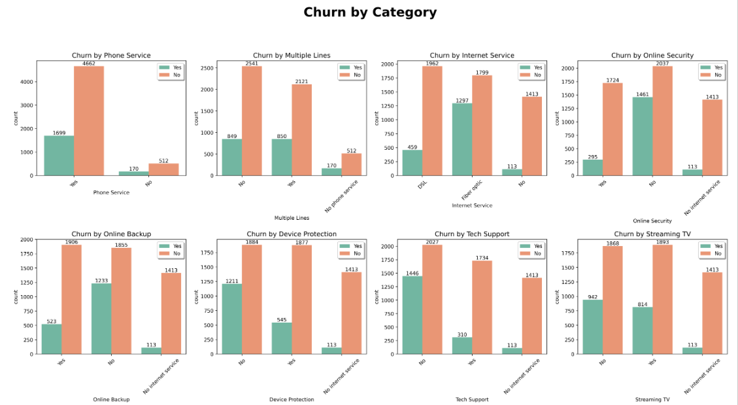
Exploratory Data Analysis cont’d
Churn analysis by service Usage Patterns reveals interesting trends. Two of these insights suggest that customers without any form of tech support or online backup a more likely to abandon their subscriptions. This means that customers who do not enjoy value-added benefits from the company are at a higher risk of churn.

Slide 13

THANK YOU
references
Aaditya Bansal. June 8, 2023. Telecommunications Industry Customer Churn Dataset. Kaggle. https://www.kaggle.com/datasets/aadityabansalcodes/telecommunications-industry-customer-churn-dataset/data
Geeks for Geeks Team. August 2, 2024. How to use Glob() function to find files recursively in Python? Geeks for Geeks. https://www.geeksforgeeks.org/how-to-use-glob-function-to-find-files-recursively-in-python/
Kurtis Pykes. Jan 15, 2025. Data Preprocessing: A Complete Guide with Python Examples. Data Camp. https://www.datacamp.com/blog/data-preprocessing
Python Geeks Team. N.d. Data Preprocessing in Machine Learning. Python Geeks. https://pythongeeks.org/data-preprocessing-in-machine-learning/
Anoop Gopalam. October 25, 2023. 8 Essential Python Libraries for Mastering Data Quality Checks. Telm AI. https://www.telm.ai/blog/8-essential-python-libraries-for-mastering-data-quality-checks/

